Slide 1
Telecom Network Performance and Operational Analytics Platform
Name: P. Sree Likithaa

Slide 2
PROBLEM STATEMENT
Telecom network operations rely on network equipment performance, customer complaints, operational costs and regulatory compliance, but these data streams remain fragmented. By integrating and analysing multi-source telecom data using data engineering. It becomes possible to predict equipment issues, identify compliant hotspots, optimize costs and ensure compliance. This leads to improved service quality, customer experience and operational efficiency.

Slide 3
TOOLS & TECHNOLOGIES
Data Ingestion – Azure Data Factory
Storage – Azure Data Lake Gen2
Processing – Azure Databricks
Analytics – Azure Synapse Analytics
Visualisation – Power BI

Slide 4
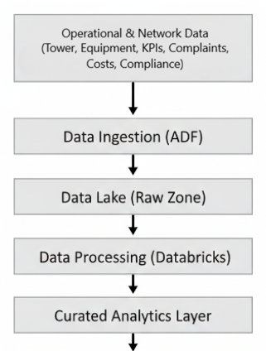

FUNCTIONAL DIAGRAM

Slide 5
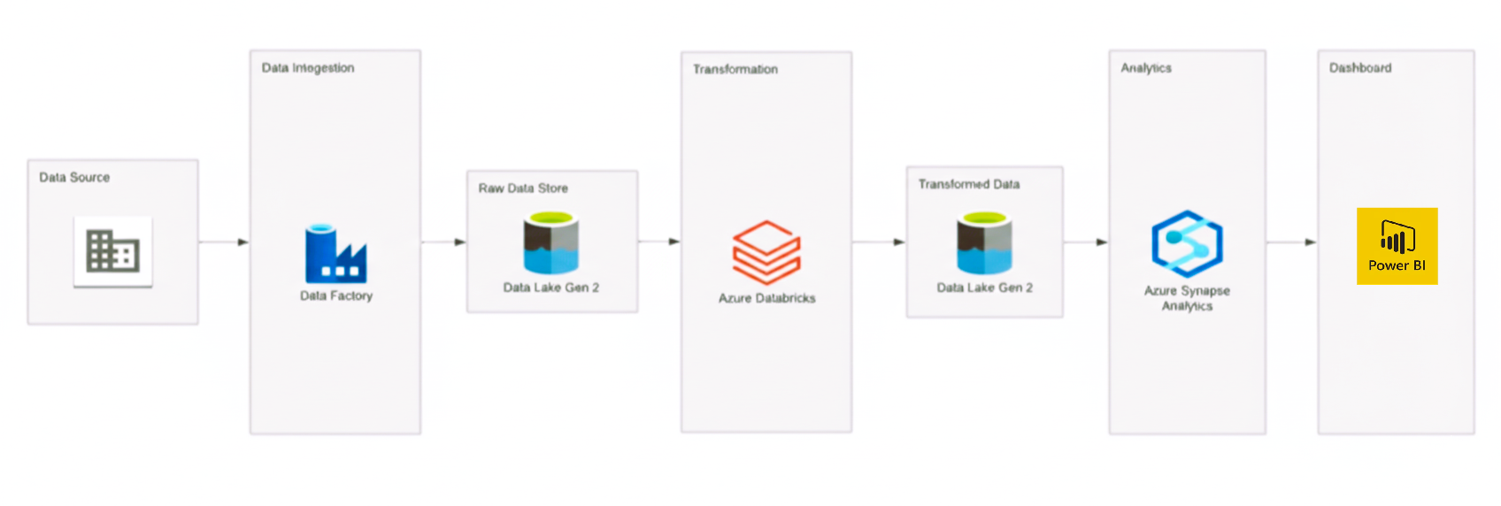
ARCHITECTURE

Slide 6
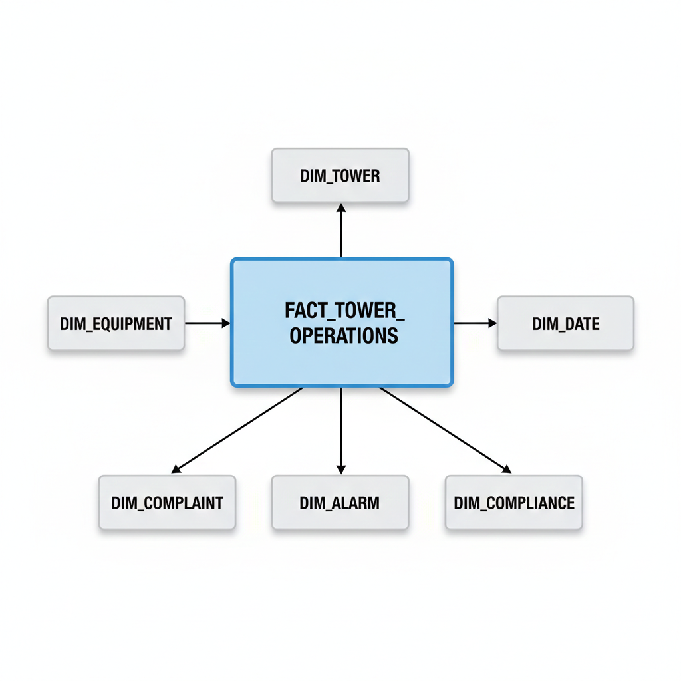
SCHEMA

Slide 7
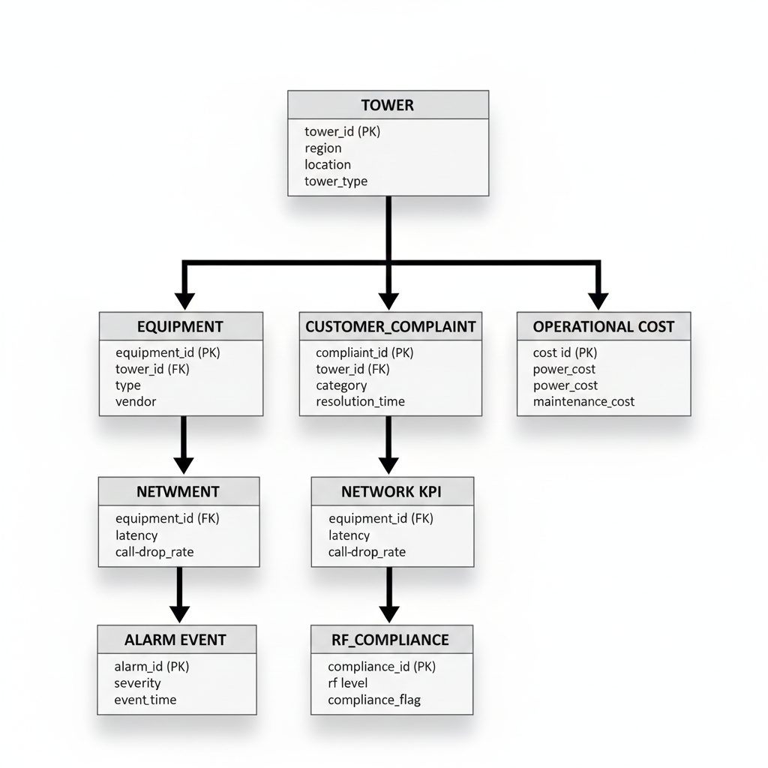
TABLES

